Slide 1
OS – Memory Deallocation
CS 0449
Jarrett Billingsley

Slide 2
Class announcements
diiiiiiiiiiiiiiiiiiiiiid you see the two announcements I made about the project yesterday?
keep an eye out for any more as we get closer to the due date
which is tomorrow
some common mistakes I’ve seen so far are:
mixing up SEEK_SET and SEEK_CUR
declaring a VLA with arr[sizeof(var)] instead of arr[var]
pixel_invert or whatever you call it taking a Pixel instead of Pixel*
pixel_swap or whatever you call it swapping the pointers instead of the values that the pointers point to

Slide 3
Let's revisit this…

Slide 4
You can't always get what you want (animated)
let's say the user did malloc(60)
30 |  | 100 |  | 40
wasted!
could we give them this whole 100B block?
they only asked for 60, so these 40 bytes are wasted.
sure, but… why is that bad?
we want to avoid internal fragmentation.

Slide 5
Splitting a free block (animated)
we want to give them exactly 60 bytes.
60B
16B
24B
??
24
30 |  | 100 |  | 40
60
1. count 60B into the block and put a new header there
2. do 100-60-sizeof(header) to get the size of the new free block
3. insert the new header into the linked list
4. update the old header to the new size and mark it used

Slide 6
Extending the heap
if we don't have any free blocks to give the user… what then?
the stuff on the heap is entirely managed by your program.
but the "real estate" that the heap occupies comes from the OS.
when your program needs more heap space…
you can ask the OS to E X P A N D H E A P
it may or may not allow that to happen!
guess what: the OS has an allocation algorithm to manage memory across programs too
it's just allocation algorithms all the way down

Slide 7
Heap Deallocation

Slide 8
A lot easier
turning a used spot into a free spot is easier than finding one was.
30 |  | 100 |  | 40
the user wants to free the 100B block.
ok.
next topic…?
Notes:
[diagram: a used 100-byte block becomes a free 100-byte block.]
- you just get out of the chair.

Slide 9
OK, there's a complication
what if we end up with two free blocks in a row?
30 |  | 100 |  | 40
well, that seems kinda silly.
what if the user wanted 120 bytes now?
why don't we do the inverse of splitting?
Notes:
- even though we have 2 free blocks in a row with >120 bytes of space, we couldn't give it to them.

Slide 10
Coalescing
if we end up with adjacent free blocks, we can coalesce them.
146B
30 |  | 100 |  | 40
146
1. sum the sizes of the two blocks + sizeof(header)
2. remove the middle header from the linked list.
3. update the first header with the new size.
Notes:
coalesce = smoosh all together

Slide 11
Can you have more than two free blocks in a row?
yep, if you free a block between two free blocks.
30 |  | 100 |  | 40
146
202
but this doesn't have to be a special case.
coalesce the first two…
and then coalesce that with the third.
Notes:
if you think about it, if you do this every time you free, you will never have more than 3 free blocks in a row.
any case where you would have ≥4 blocks, it could only arise if you forgot to coalesce on a previous free.
after coalescing, there are only single free blocks between used ones.

Slide 12
Making allocation faster

Slide 13
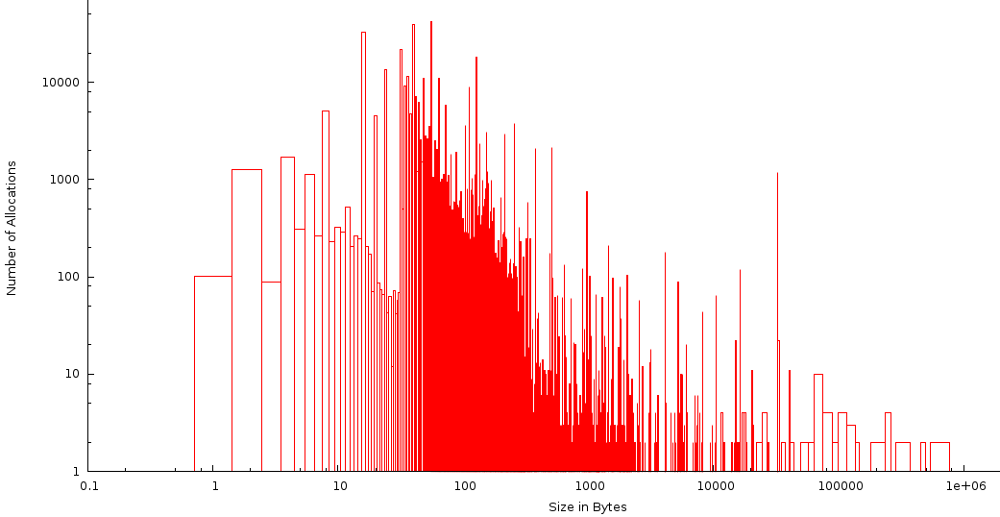
Expect the.. expected
if you graph the size of allocations against the frequency of those allocations (how many blocks of that size are allocated) you get:
frequency is inversely proportional to size
we usually allocate lots of little things, and only a few big things
this graph is not universal – but many programs follow similar trends
diagram from http://milianw.de/blog/heaptrack-a-heap-memory-profiler-for-linux
Notes:
[diagram: a histogram. it's a log-log plot. the horizontal axis is the size of each allocation in bytes. the vertical axis is how many allocations of that size were made. the distribution is roughly chi-squared, like a bell curve but leaning to the left. most of the allocations are centered around 50 to 500 bytes.]

Slide 14
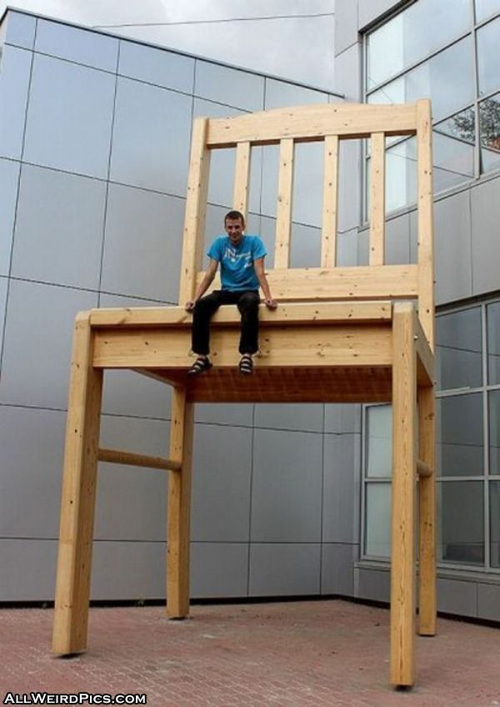
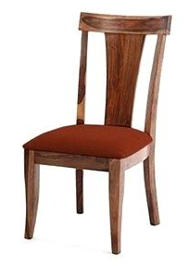
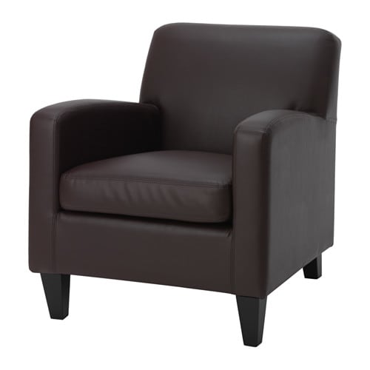
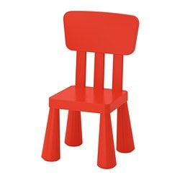
Musical chairs
think of it like… chairs of different sizes.
if someone small (a kid?) wants a chair, which chairs do we even care about?
the tiny chair.
why bother looking at chairs that you know are the wrong size?
Notes:
[diagram: four chairs of increasing size.]
- that giant chair is internally fragmented!!

Slide 15
Quick-fit
instead of using a single linked list for the whole heap....
let's have multiple lists, based on size.
"small"
"medium"
"large"
now if someone asks for a big block…
it's right there.
Notes:
[diagram: a heap with varying sizes of used and free blocks. we have three lists, arbitrarily called small, medium, and large. each list only holds free blocks of a particular range of sizes.]

Slide 16
Throw it in the bin
a quick-fit scheme keeps several bins of varying sizes
maybe based on powers of 2
maybe linearly spaced
who knows
you can think of each bin as a "set of free blocks in that size range"
allocation becomes much faster, as we can immediately know if there's a block of the "right" size
on deallocation, we insert the newly-freed block into the right bin
this is a pretty cool time-space tradeoff!

Slide 17
Memory Pooling

Slide 18
Expect the.. expected
the vast majority of our allocations are in this size range (for this program, about 32~512 bytes).
so why don’t we plan ahead?
this graph again
diagram from http://milianw.de/blog/heaptrack-a-heap-memory-profiler-for-linux
Notes:
[diagram: the same histogram from before. the portion from about 32 to about 512 bytes is highlighted.]

Slide 19
Adult swim (animated)
if our program is going to need 10,000 128-byte objects, let’s just preallocate 1.28MB of space – we call this a pool
we can very quickly slice new allocations off the pool
when objects are deleted, this leaves perfectly-sized holes
which means external fragmentation is effectively eliminated!
several pools paired with a quick-fit allocator can be really fast.
but what’s the downside?
Notes:
[diagram: a big empty area of memory. when we allocate, since everything is the same size, allocation is very quick and easy. and when we deallocate, the holes left by those objects are uniformly sized and easy to reuse.]

Slide 20
You can’t please everyone
this kind of memory pooling doesn’t work in the general case
it works great for some programs and terribly for others!
the allocator either has to:
know about it in advance; or
adapt dynamically
which means doing more work during allocation
which means slowing down allocation
the default glibc malloc does some pooling by keeping pools of small objects after they’ve been allocated and freed
it tries to balance several factors, so it’s kind of a well-rounded memory allocator without being the best at anything
it's the Mario of mallocs

Slide 21
Heap compaction??

Slide 22
Move down!!!!!
you're trying to parallel park
why can't everyone just MOVE DOWN cause THEN I'D HAVE ROOM TO PARK
oh COME ON
this is the idea behind heap compaction
Notes:
[diagram: three cars parallel-parked. they are spaced out by about half a car length between them. a fourth car pulls up and is unable to park, even though there WOULD be enough space if everyone KNEW HOW TO PARK]

Slide 23
Intractable
let's say we have this situation
if I want to move that block to the left, what do I have to do to the head pointer?
head
I have to change the pointer, too.
I have to change every pointer that points to that block.
this is completely unworkable.
but remember: every problem in CS can be solved with another level of indirection…
Notes:
[diagram: we have some pointer in our program. it points at a particular block on the heap. if we want to move the heap block towards one side, that means we have to change where the pointer points. but there can be an unlimited number of pointers that point to that block.]

Slide 24
Tractable (animated)
instead of pointing directly to the heap, we make EVERY pointer…
Heap Pointers
…point to a pointer.
now we can have unlimited pointers to that pointer
and if we want to move the block, we update the one pointer in the table.
head
n
what are the downsides?
prev
Notes:
[diagram: now there is an intermediate table of heap pointers. we can have any number of pointers in our program, and they will all point at one entry in the table. when the heap block moves, we only need to update one entry in the table, and all our program's pointers can remain unchanged.]
- it's slower
- it requires you to only access the heap through this double-pointer mechanism
- you cannot rely on things "staying put" (which is sometimes important)

Slide 25
Wellllll guess what, we can't do it in C
Java does this…
because they designed it from the start to be able to do this.
doing this requires:
perfect knowledge of where every block is
no pointers to the "insides" of blocks (“address of array item”)
no access to the heap without these double-pointers
you could do this in C if you were reaaally disciplined
but there's absolutely nothing preventing you from messing up.

